Slide 1
Appendix D: Distributed Communication
Sockets
Remote Procedure Calls (RPCs)
Remote Method Invocation (RMI)
CORBA
Object Registration

Slide 2
Sockets
Defined as an “endpoint for communication”
Concatenation of IP Address + Port
All Ports < 1024 are Considered “well-known”
- TELNET uses port 23
- FTP uses port 21
- HTTP server uses port 80

Slide 3
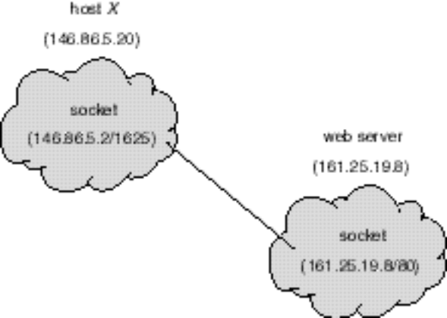
Communication Using Sockets

Slide 4
Java Sockets
Java Provides:
- Connection-Oriented (TCP) Sockets
- Connection-less (UDP) Sockets
- Multicast Connection-less Socket

Slide 5
Time-Of-Day Server/Client
Server uses
s = new ServerSocket(5155)
To Create the Socket on Port 5155
To Accept Connections From Clients:
Socket client = s.accept()
Connections are Often Serviced in Separate Threads
The Client Connects to the Server Using:
Socket s = new Socket(“127.0.0.1”,5155);
Using the IP Address of the Server.

Slide 6
Remote Procedure Calls (RPC)
Sockets are Considered Low-level.
RPCs Offer a Higher-level Form of Communication
Client Makes Procedure Call to “Remote” Server Using Ordinary Procedure Call Mechanisms.

Slide 7
Remote Method Invocation (RMI)
Java’s Version of RPCs
A Thread May Invoke a Method on a Remote Object
An Object is Considered “remote” if it Resides in a Separate Java Virtual Machine.

Slide 8
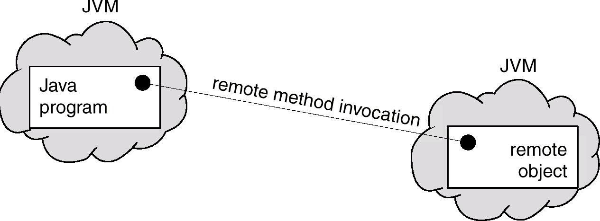
Remote Method Invocation (BMI)

Slide 9
RPC versus RMI
RPC’s Support Procedural Programming Style
RMI Supports Object-Oriented Programming Style
Parameters to RPCs are Ordinary Data Structures
Parameters to RMI are Objects

Slide 10
Stubs and Skeletons
“Stub” is a Proxy for the Remote Object – Resides on Client.
The Stub “Marshalls” the Parameters and Sends Them to the Server.
“Skeleton” is on Server Side.
Skeleton “Unmarshalls” the Parameters and Delivers Them to the Server.

Slide 11
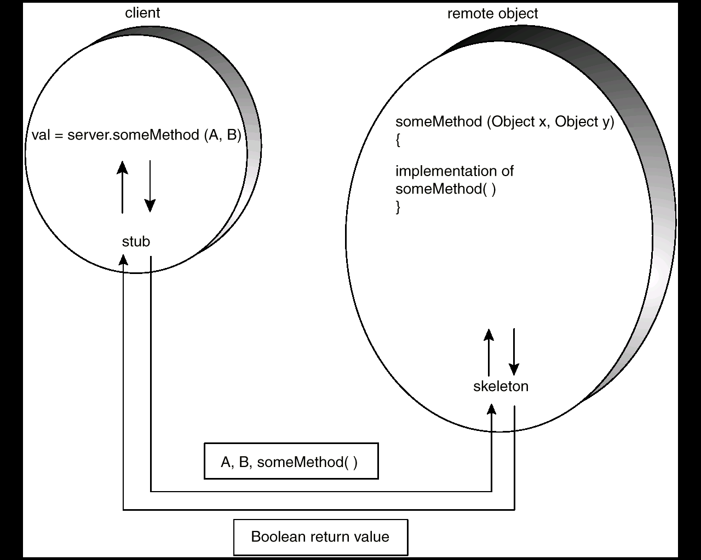
Marshalling Parameters

Slide 12
Parameters
Local (Non-Remote) Objects are Passed by Copy using Object Serialization
Remote Objects are Passed by Reference

Slide 13
Remote Objects
Remote Objects are Declared by Specifying an interface that extends java.rmi.Remote
Every Method Must Throw java.rmi.RemoteException

Slide 14
MessageQueue interface
public interface MessageQueue
extends java.rmi.Remote
{
public void send(Object item)
throws java.rmi.RemoteException;
public Object receive()
throws java.rmi.RemoteException;
}

Slide 15
MessageQueue implementation
public class MessageQueueIMPL
extends java.rmi.server.UnicastRemoteObject
implements MessageQueue
{
public void send(Object item)
throws java.rmi.RemoteException
{ /* implementation */ }
public Object receive()
throws java.rmi.RemoteException
{ /* implementation */ }
}

Slide 16
The Client
The Client Must
(1) Install a Security Manager:
System.setSecurityManager(
new RMISecurityManager());
(2) Get a Reference to the Remote Object
MessageQueue mb;
mb = (MessageQueue)Naming.
lookup(“rmi://127.0.0.1/MessageServer”)

Slide 17
Running the Producer-Consumer Using RMI
Compile All Source Files
Generate Stub and Skeleton
rmic MessageQueueImpl
Start the Registry Service
rmiregistry
Create the Remote Object
java –Djava.security.policy=java.policy MessageQueueImpl
Start the Client
java –Djava.security.policy=java.policy Factory

Slide 18
Policy File
New with Java 2
grant {
permission java.net.SocketPermission "*:1024-65535","connect,accept";
};

Slide 19
CORBA
RMI is Java-to-Java Technology
CORBA is Middleware that Allows Heterogeneous Client and Server Applications to Communicate
Interface Definition Language (IDL) is a Generic Way to Describe an Interface to a Service a Remote Object Provides
Object Request Broker (ORB) Allows Client and Server to Communicate through IDL.
Internet InterORB Protocol (IIOP) is a Protocol Specifying how the ORBs can Communicate.

Slide 20
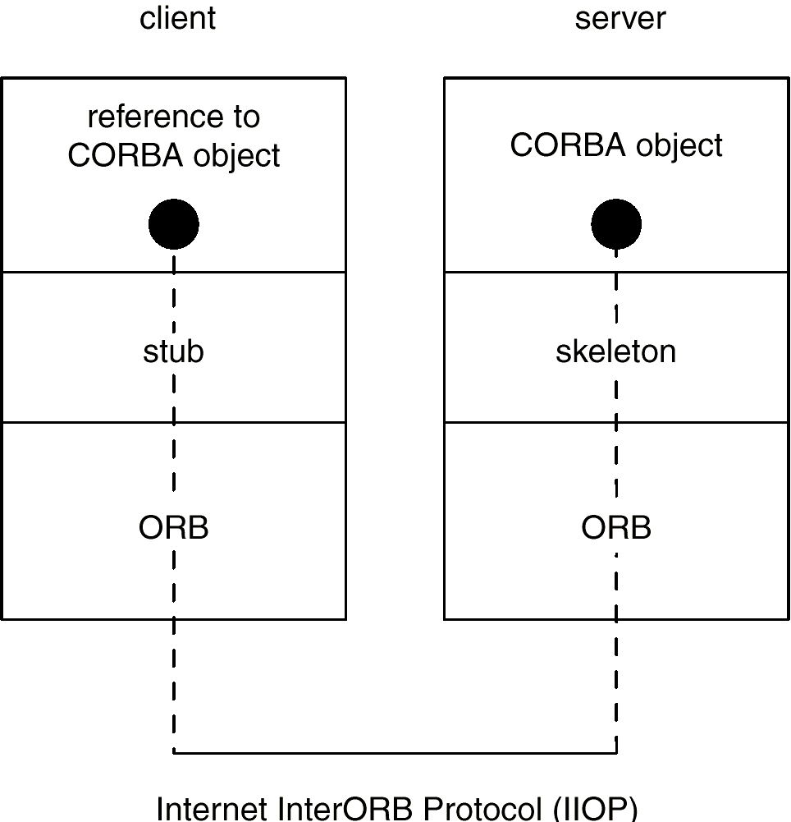
Cobra Model

Slide 21
Registration Services
Registration Service Allows Remote Objects to “register” Their Services.
RMI, CORBA Require Registration Services

